Slide 1
JavaScript architecture via
Yeoman & Angular 2013-09-30
Filip Stenbeck & Björn Sjögren

Slide 2
JavaScript Arkitektur
Modules
Dependency Injection
Model-View-Controller (MVC)
Mediator

Slide 3

Modules

Slide 4
Modules
Emulate classes
Private variables (closures)
Protect the global namespace
Code structure
JQuery, Dojo, ExtJs, YUI, RequireJS (AMD), CommonJS, AngularJS and many more.

Slide 5
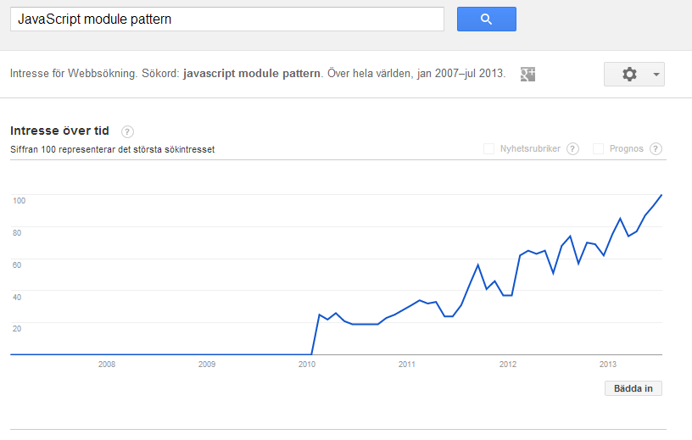
Modules

Slide 6
“Crockfords module patterns”
function Calculator() {
//Private
var sum = 0;
//Public
return {
add: function(x) {
sum += x;
return this;
},
reset : function() {
sum = 0;
return this;
},
getSum: function() {
console.log(sum);
}
};
};
var calc = new Calculator();
calc.add(4).add(8);
calc.getSum(); //12
calc.reset().getSum(); //0
console.log(sum); //undefined

Slide 7
Revealing module pattern
var calc = function Calculator() {
var sum = 0, version = '1.0';
function add(x) {
sum += x;
return this;
};
function reset () {
sum = 0;
return this;
};
function getSum () {
console.log(sum);
}
// public pointers to private functions and properties
return {
version : version,
add : add,
reset: reset,
getSum : getSum
}
};
calc.add(4).add(8);
calc.getSum(); //12
calc.reset().getSum(); //0

Slide 8
Facade
function Calculator() {
var sum = 0;
var module = {
add: function(numbers) {
numbers.forEach(function(value) {
sum = sum + value;
});
},
reset : function() {
sum = 0;
},
printSum: function() {
console.log('Result ' + sum);
}
};
return {
add : function() {
var args = Array.prototype.slice.call(arguments);
module.reset();
module.add(args);
module.printSum();
},
};
};
var calc = new Calculator();
calc.add(4, 8); //12
calc.add(4, 8, 4); //16

Slide 9

Facade
$('#table');
$('.table');
$('table');

Slide 10

Modules in AngularJS

Slide 11
AngularJS moduler
AngularJS has no 'main' only modules
Modules which are dependent on other modules
Must be declared in a special way
Easy to use third party modules
Easy to publish your modules
And you should use a module pattern anyway

Slide 12
Moduler i AngularJS
//Define modules and their dependencies
angular.module('PersonModule', []);
angular.module('SaleryModule', []);
angular.module('EmployeeModule', ['PersonModule','SaleryModule']);
// Define a "main" module and inject all other modules
angular.module('HRApp',['EmployeeModule'])
//Use the “main” module
angular.module('HRApp').controller('MainCtrl', function ($scope) {

Slide 13

Dependency Injection

Slide 14

Dependency Injection
Instead of letting an object be responsible for creating the objects it depends on, the object is 'injected' at runtime.
Also Known As 'Inversion of Control' and has long been popular. (Java,. NET, C + +, PHP, etc.)

Slide 15
Dependency Injection in AngularJS

Slide 16
Dependency Injection
Dependency Injection is a big part of AngularJS...
...and it just works.

Slide 17
Dependency Injection (angular way)
app.service("stuffService", function stuffService($http) {
var url = 'http://localhost/stuff/';
var getStuffFromServer = function(callback) {
$http({method: 'GET', url: url}).success(
function(data, status, headers, config) {
callback(data);
})
};
return {
getSome : getStuffFromServer
}
});
app.controller("listCtrl", function ($scope, stuffService) {
$scope.getData = function () {
searchService.getSome(function (data) {
$scope.result = data;
});
}
})

Slide 18
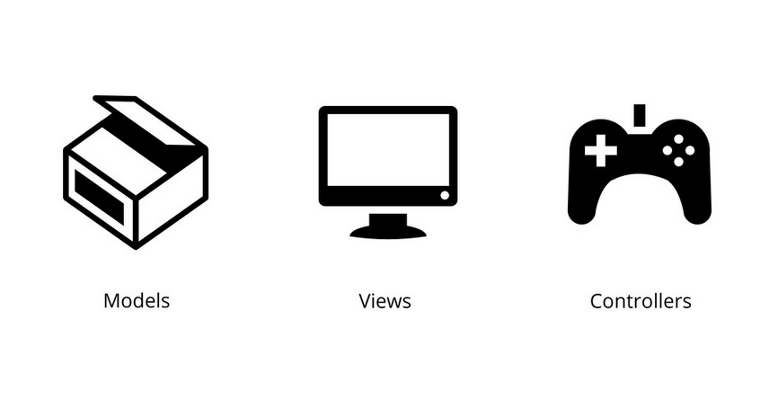
Model - View - Controller

Slide 19
Model - View - Controller
1978

Slide 20

Model - View - Controller
Wins gold medal at the Alpine Ski World Championships in Garmisch-Partenkirchen.

Slide 21
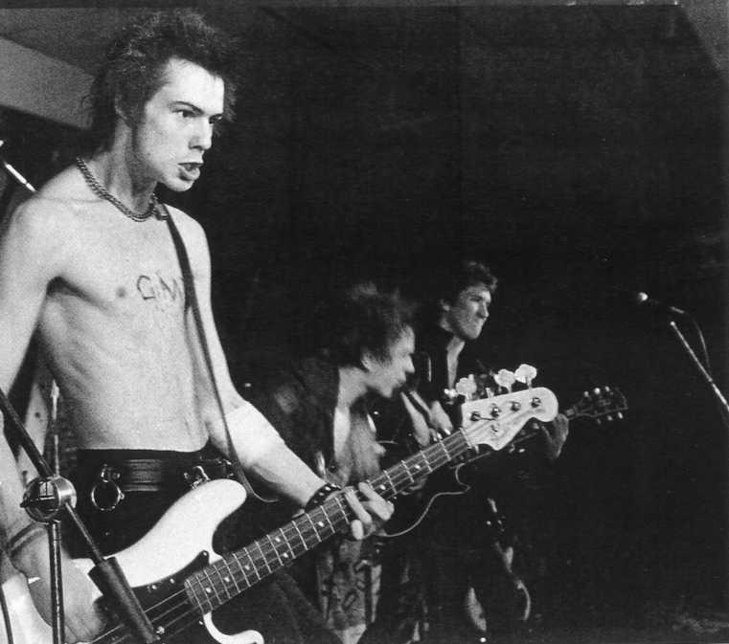
Model - View - Controller
On their last show, they play only one song, the Stooges cover, "No Fun" and then leaves the stage.

Slide 22
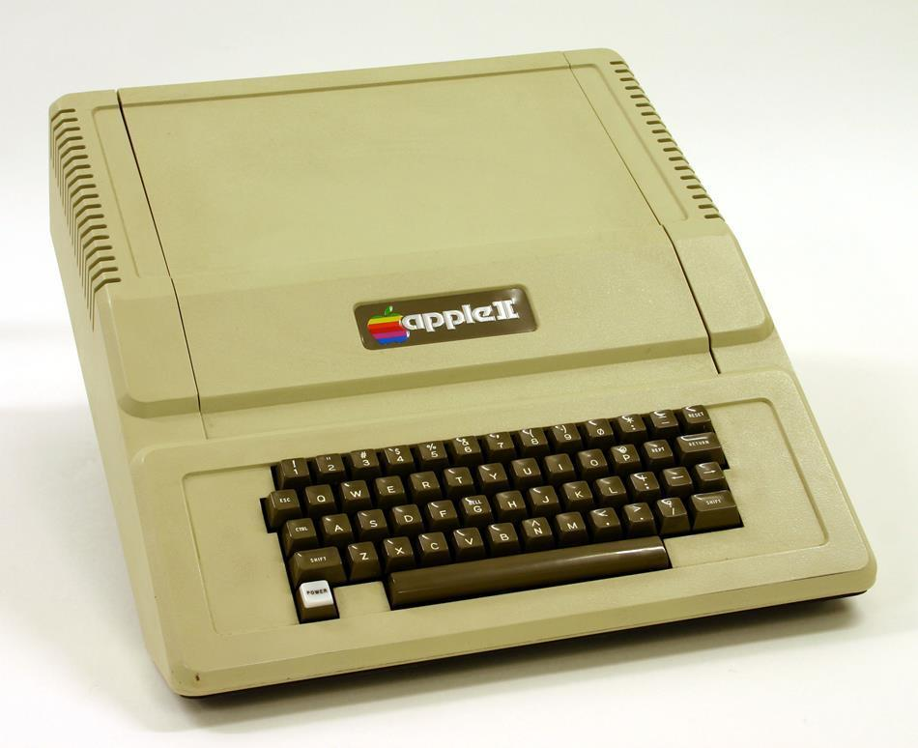
Model - View - Controller
Apple's new 'monster' looked like this.

Slide 23
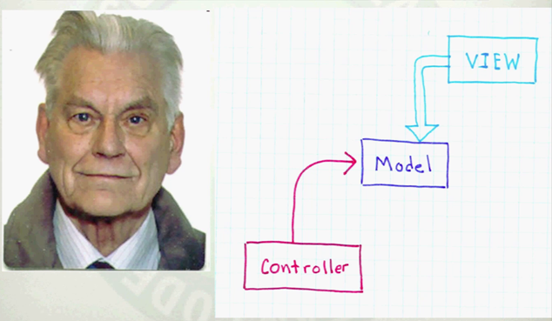
Model - View - Controller
Tryggve Reenskaug
“The hardest part was to hit upon good names
for the different architectural components”

Slide 24
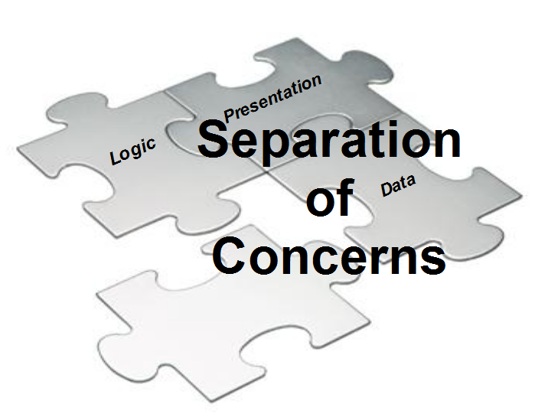
Model - View - Controller

Slide 25
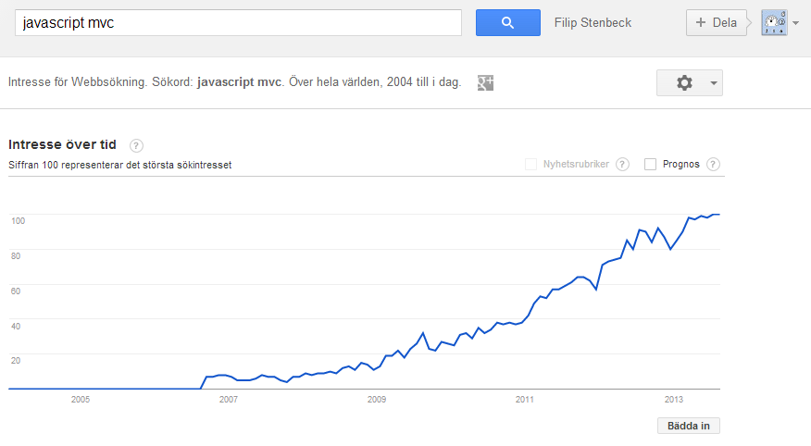
Model - View - Controller

Slide 26
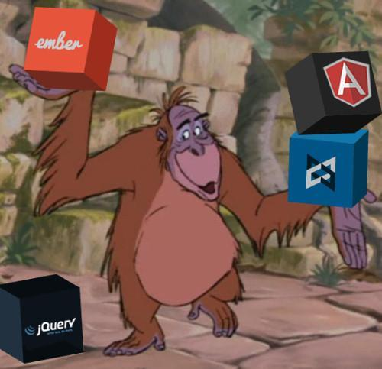
Model - View - Controller

Slide 27
MVC Theory

Slide 28
Model
Domain specific data
Notify changes by 'events'
Isolated from the view
Changed by one or more controllers

Slide 29
View
Application UI
Know about and observes Models
Have info about the model's properties
Can observed several models
Multiple views can observe the same model

Slide 30
Controller
Handles user input
Changing Models
Do not update views

Slide 31
View / Controller
Controls manage input
Views manages output

Slide 32
MVC in AngularJS

Slide 33

MVC i AngularJS
JavaScript POJOs
‘foobar’, { } or [ ]
Two-way Data binding
HTML superset
ng- annotations
Directives <elements>
Templates
{{ }}
JS to change the model,
API to manage the 'scope'
No DOM manipulation

Slide 34

Mediator

Slide 35
Mediator
JavaScript is event based
Can be difficult to get an overview
An interface for communication within an app

Slide 36
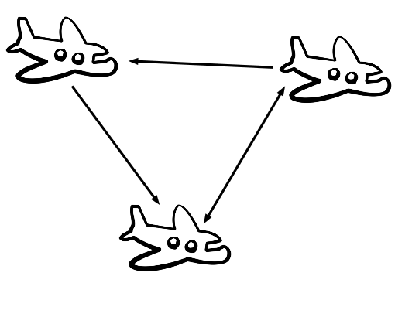
Mediator

Slide 37
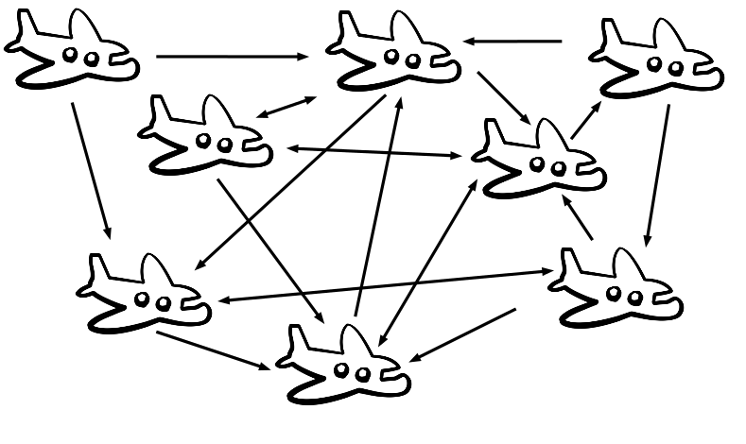
Mediator

Slide 38
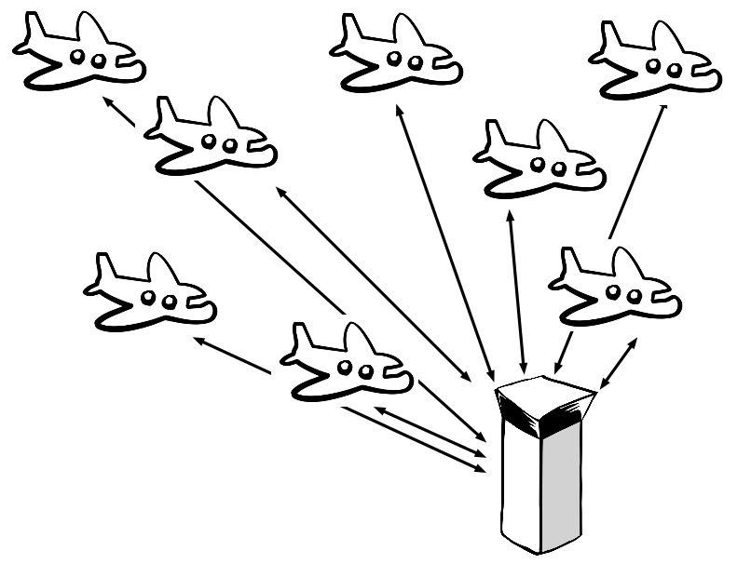
Mediator

Slide 39
Mediators in AngularJS

Slide 40
Mediators in AngularJS
AngularJS === Mediator
Two-way data binding & $on, $broadcast() , $emit()
But it also works well to combine AngularJS with your own mediator
Custom mediator in AnfgularJS demo

Slide 41
AngularJS - History

Slide 42
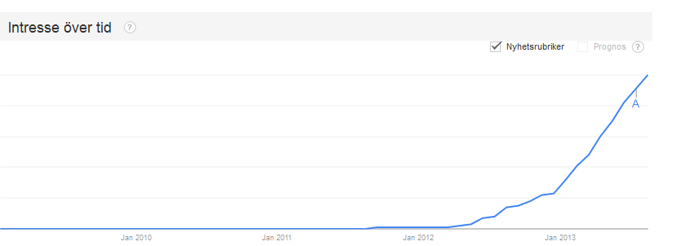
AngularJS - History
Google wanted to make the creation of Single Page Applications efficient
Created in 2009 as an internal Google project
Opinionated Model-View-Controller framework
1.0 was released June 13, 2012
Open Source

Slide 43
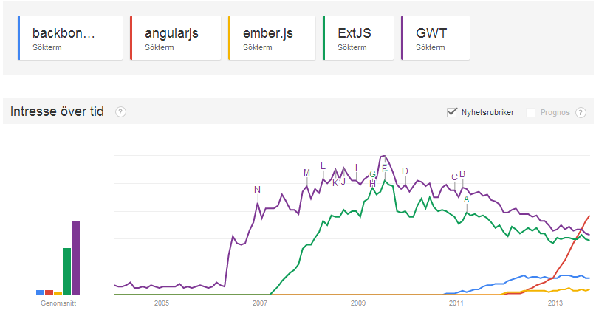
AngularJS -History

Slide 44
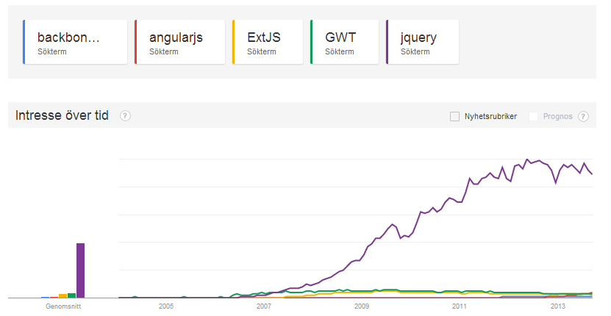
AngularJS -History

Slide 45
Working with AngularJS

Slide 46
Angular JS - Hello world [Demo]
<!DOCTYPE html>
<html data-ng-app="">
<head><title>Angular Hello</title></head>
<body>
<div data-ng-controller="SimpleController">{{msg}}</div>
<script>
function SimpleController($scope) {
$scope.msg = "Hello Angular JS :)";
}
</script>
<!-- Kick of angularjs -->
<script src="https://ajax.googleapis.com/ajax/libs/angularjs/1.0.7/angular.min.js"></script>
</body>
</html>

Slide 47
Angular JS - Concepts
Controllers expose model objects and methods to a view (via the use of $scope). They contain view-specific code without any DOM manipulations.
Services contain methods which perform view-independent operation. Business-logic code which is used by multiple views and/or in different contexts is right at home here. (Note: some global services might even operate on the DOM level -- for example to show modal dialog boxes or similar. These manipulations should however be independent from of concrete view in your application.)
Directives are re-usable components which bind model values to DOM properties and react on DOM events to update model values
Model are plain objects or arrays jada jada
Filters format data for display to the users.

Slide 48
Angular JS - Data binding [Demo]
<!DOCTYPE html><html ng-app> <head><title>Hello Angular</title></head> <body> <!-- Data binging example --> <div> Name: <input type="text" ng-model="yourName" /> {{ yourName }} </div>
<script src="https://ajax.googleapis.com/ajax/libs/angularjs/1.0.7/angular.min.js"></script> </body> </html>

Slide 49
Angular JS - Controllers [Demo]
<!DOCTYPE html>
<html ng-app>
<head><title>Hello Angular</title></head>
<body>
<div data-ng-controller="SimpleController">
Name: <input type="text" ng-model="yourName" /> {{ yourName }}
</div>
<!-- A controller -->
<script>
function SimpleController($scope) {
$scope.yourName = "John \"Default\" Doe";
}
</script>
<script src="https://ajax.googleapis.com/ajax/libs/angularjs/1.0.7/angular.min.js"></script>
</body>
</html>

Slide 50
Angular JS - Lab 1 - Hello Angular
Lab 1 - Hello Angular
Create your first Angular web application
Make the page AngularJS aware
Connect the <input> and the <h1> to a model
Initialize the model with a value

Slide 51
Angular JS - Watch [Demo]
<!DOCTYPE html>
<html ng-app>
<head><title>Hello Angular</title></head>
<body>
<div ng-controller="SimpleController">
<input type="text" ng-model="word">
<span>Length: {{wordLength}}</span>
</div>
<script>
function SimpleController($scope) {
$scope.wordLength = "0";
$scope.word = "";
$scope.$watch("word", function(newValue, oldValue) {
$scope.wordLength = newValue.length;
});
}
</script>
...
</body>
</html>

Slide 52
Angular JS - Lab 2 - Watch Angular
Lab 2 - Watch Angular
Listen to model changes
Make the counter update everytime the message changes
Use css to make the number first GREEN then RED when the counter reach 10
//Hint use $scope.$watch to listen for changes
//Hint use AngularJS to set CSS classes ‘.normal’ and ‘.warning’

Slide 53
Angular JS - Iterating [Demo]
<!DOCTYPE html><html ng-app> <head><title>Hello Angular</title></head> <body> <div data-ng-controller="SimpleController"> <h3>Looping with the ng-repeat directive</h3> <ul> <li data-ng-repeat="personName in names">{{personName}}</li> </ul> </div> <script> function SimpleController($scope) { $scope.names = ['Dave', 'Napur', 'Heedy', 'Shriva']; } </script> <script src="https://ajax.googleapis.com/ajax/libs/angularjs/1.0.7/angular.min.js"></script> </body></html>

Slide 54
Angular JS - Lab 3 - Iterating
Lab 3 - Iterating
Use the Hello World Lab
Change the model to an array of messages
Change the View to display an array of messages

Slide 55
Angular JS - Show/Hide [Demo]
<!DOCTYPE html>
<html ng-app>
<head><title>Hello Angular</title></head>
<body>
Click me: <input type="checkbox" ng-model="checked"><br/>
<div ng-show="checked">Checkbox is now checked!</div>
<br/>
Click me 2: <input type="checkbox" ng-model="checked2"><br/>
<div ng-hide="checked2">Checkbox is now unchecked!</div>
<script src="https://ajax.googleapis.com/ajax/libs/angularjs/1.0.7/angular.min.js"></script>
</body>
</html>

Slide 56
Angular JS - Conditional 1(3) [Demo]
<!DOCTYPE html>
<html ng-app>
<head><title>Hello Angular</title></head>
<body>
<div ng-controller="SimpleController">
<select ng-model="selectedColor" ng-options="color as color.name for color in colors"></select>

Slide 57
Angular JS - Conditional 2(3) [Demo]
<div ng-switch on="selectedColor.id">
<div ng-switch-when="red">
<div style="background-color: red;">Red</div>
</div>
<div ng-switch-when="green">
<div style="background-color: green;">Green</div>
</div>
<div ng-switch-when="blue">
<div style="background-color: blue;">Blue</div>
</div>
<div ng-switch-default>&nbsp;</div>
</div>
</div>

Slide 58
Angular JS - Conditional 3(3) [Demo]
<script>
function SimpleController($scope) {
$scope.colors = [
{"id": "red", "name": "Red"},
{"id": "green", "name": "Green"},
{"id": "blue", "name": "Blue"}
];
}
</script>
<script src="https://ajax.googleapis.com/ajax/libs/angularjs/1.0.7/angular.min.js"></script>
</body>
</html>

Slide 59
Angular JS - Classes 1(2) [Demo]
<!DOCTYPE html>
<html ng-app>
<head><title>Hello Angular</title></head>
<body>
<div ng-controller="SimpleController">
<select ng-model="selectedColor" ng-options="color as color.name for color in colors"></select>
<div
style="margin: 3px; padding: 2px; width: 50px; height: 50px; background-color: red;"
ng-style="{'background-color':selectedColor.id}">
{{selectedColor.name}}
</div>
</div>

Slide 60
Angular JS - Classes 2(2) [Demo]
<script>
function SimpleController($scope) {
$scope.colors = [
{"id": "red", "name": "Red"},
{"id": "green", "name": "Green"},
{"id": "blue", "name": "Blue"}
];
$scope.selectedColor = {
"id": "white",
"name": ""
};
}
</script>
<script src="https://ajax.googleapis.com/ajax/libs/angularjs/1.0.7/angular.min.js"></script>
</body>
</html>

Slide 61
Angular JS - Click [Demo]
<!DOCTYPE html>
<html ng-app>
<head><title>Hello Angular</title></head>
<body>
<div ng-controller="SimpleController">
<span ng-click="doSomething()" style="cursor:pointer;">Click Me</span><br/>
<div style="width: 70px; height: 30px; background-color: yellow; padding: 10px;" ng-show="checked">Clicked!</div>
</div>
<script>
function SimpleController($scope) {
$scope.checked = false;
$scope.doSomething = function() {
$scope.checked = !$scope.checked;
}
}
</script>
<script src="https://ajax.googleapis.com/ajax/libs/angularjs/1.0.7/angular.min.js"></script>
</body>
</html>

Slide 62
Angular JS - Submit [Demo]
<!DOCTYPE html>
<html ng-app>
<head><title>Hello Angular</title></head>
<body>
<form ng-submit="submit()" ng-controller="SimpleController">
Enter text and hit enter:
<input type="text" ng-model="text" name="text" />
<input type="submit" id="submit" value="Submit" />
<pre>list={{list}}</pre>
</form>
<script>
function SimpleController($scope) {
$scope.text = "";
$scope.list = [];
$scope.submit = function() {
if ($scope.text) {
$scope.list.push($scope.text);
$scope.text = '';
}
};
}
</script>
...

Slide 63
Angular JS - API
http://docs.angularjs.org/api/

Slide 64
Angular JS - Directives and filters [Demo]
<!DOCTYPE html><html data-ng-app=""> <head><title>Angular directives and filters</title></head> <body data-ng-controller="SimpleController">Filter: <input type="text" data-ng-model="name" /> {{ name }}<br/> <ul> <li data-ng-repeat="cust in customers | filter:name ">{{cust.name | uppercase}} - {{cust.city | lowercase}}</li> </ul> <script> function SimpleController($scope) { $scope.customers = [ {name:'John Smith',city:'Pheonix'}, {name:'John Doe',city:'New York'}, {name:'Ada Bertil',city:'Fun City'} ]; } </script>
...

Slide 65
Angular JS - Bootstrap & Controllers
...
<script src="https://ajax.googleapis.com/ajax/libs/angularjs/1.0.7/angular.min.js"></script> <script>var demoApp = angular.module("demoApp", []); var controllers = {}; controllers.SimpleController = function ($scope) {
$scope.customers = [ {name:'John Smith',city:'Pheonix'}, {name:'Adam Doe',city:'Atlanta'}, {name:'Karl Svensson',city:'Stockholm'}, {name:'John Doe',city:'New York'}
]; }; demoApp.controller(controllers);</script> ...

Slide 66
Angular JS - Bootstrap & Controllers
…
<script src="https://ajax.googleapis.com/ajax/libs/angularjs/1.0.7/angular.min.js"></script>
<script src="https://ajax.googleapis.com/ajax/libs/angularjs/1.0.7/angular-resource.min.js"></script> <script>var demoApp = angular.module("demoApp", [“ngResource”]); demoApp.controller(“SimpleController”, function ($scope) { … });</script> ...

Slide 67
Angular JS - Your Own Directives - View 1(3) [Demo]
<div ng-app="myApp" ng-controller="SumController"> Current Value: {{someData.sum}} <br> <button my-confirm-click="increment(2)" >Increment by 2</button>
</div>

Slide 68
Angular JS - Your Own Directives - Controller 2(3) [Demo]
angular.module("myApp", []);
function SumController($scope) {
$scope.someData = {
sum: 42
};
$scope.increment = function (valueToAdd) {
$scope.someData.sum = $scope.someData.sum + valueToAdd;
}
}

Slide 69
Angular JS - Your Own Directives - Directive 3(3) [Demo]
var module = angular.module("myApp", []);module.directive("myConfirmClick", function ($parse) { return {
restrict: 'A',
link: function (scope, element, attrs) {
var parsed = $parse(attrs.myConfirmClick);
element.bind("click", function () {
alert("Handling the click!");
scope.$apply(function(){
parsed(scope);
});
});
}
}
});

Slide 70
Angular JS - Your Second Own Directives - View 1(3) [Demo]
<my-widget title="Widget Title">
This is some content of my custom widget ...
</my-widget>

Slide 71
Angular JS - Your second Own Directives - Directive 2(3) [Demo]
var myApp = angular.module("myApp", []);
myApp.directive('myWidget', function () {
return {
restrict: 'E',
replace: true,
transclude: true,
template: '<div class="widget">' +
'<div class="content" ng-transclude></div>' +
'</div>',
link: function (scope, element, attrs) {
element.prepend("<div class='title'>" + attrs.title + "</div>");
}
};
});

Slide 72
Angular JS - Your second Own Directives - Directive 3(3) [Demo]
<my-widget title="Outer Widget">
This is some content of my outer widget. <br>
As part of it, it contains an inner widget.
<my-widget title="Inner Widget">
This now is the content of my inner widget ...
</my-widget>
</my-widget>

Slide 73
Angular JS - Lab 4 - Hello Directive
Lab 4 - Hello Directive
Create a hello world directive tag that displays a messages small or big and changes its message when it is clicked on
Check the View (html) to see the Directories attributes
Fill in the blanks in the helloDirective
Set the message
Make the directive handle large text
Add behavior to change message when clicked
// Hint Use element[0] to access the DOM-node in the directive

Slide 74
Angular JS - Broadcast 1(2) - View [Demo]
<div ng-controller="MyCtrl">
<input
type="button"
ng-click="sendMessage()"
value="Send Message">
</div>

Slide 75
Angular JS - Broadcast 1(2) - Controller [Demo]
var myApp = angular.module('myApp', []);
myApp.controller('MyCtrl', function($scope, $rootScope) {
console.log('listening');
$scope.$on('message', function(message){
console.log(message);
console.log('hi');
});
$scope.sendMessage = function() {
var message = {
type: 'channel',
action: 'create',
data: { name: "ssss", id: 0}};
$rootScope.$broadcast('message', message)
console.log('broadcasting');
};
});

Slide 76
Angular JS - Lab 5 - Broadcast
Lab 5 - Broadcast
Create two buttons that triggers broadcasts
Make a panel that shows number of messages received
and from where the last message was sent (button)
//Hint use $scope.$broadcast and $scope.$on

Slide 77

Geoman - Introduction

Slide 78


Yeoman - Full stack

Slide 79
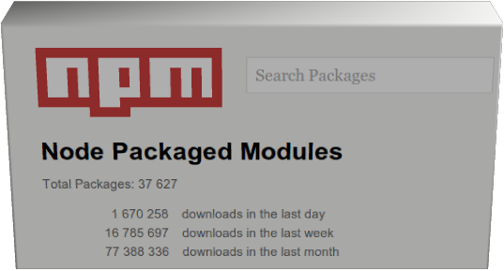
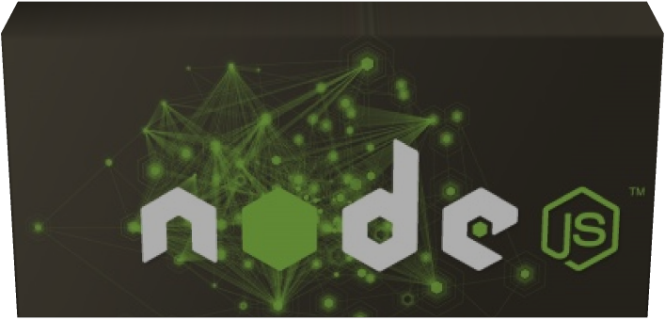
Yeoman - Node.js

Slide 80

Yeoman - Yo
'Scaffolding tool'
Generators
HTML5 boilerplate
Node.js
RequireJs
Backbone
AngularJS
Create the Grunt configuration
Create the Bower configuration

Slide 81

Yeoman - Bower
Taskrunner
Live (reload) server
Compile
Copy, move, concatenate
Minification
Test
Jshint/JsLint

Slide 82

Yeoman - Bower
Package manager for the web
Dependencies
Uses Git

Slide 83
Yeoman - The creators
Addy Osmani
Sindre Sorhus
Brian Ford
Eric Bidelman
Paul Irish
Mickael Daniel
Pasca1 Hartig
Stephen S.wchuk
Frederick R0s

Slide 84
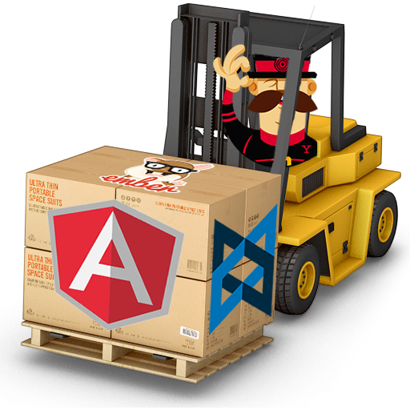
Yeoman - Demo

Slide 85
Yeoman Lab 6- Install
Lab 6 - Install Yeoman
Install Node.js http://nodejs.org/
Install Yeoman http://yeoman.io/gettingstarted.html
Install the AngularJs generator
Use Yeoman to create a new AngularJs web app

Slide 86
Angular JS - Routing
angular.module('pocApp', [])
.config(function ($routeProvider) {
$routeProvider
.when('/', {
templateUrl: 'views/main.html',
controller: 'MainCtrl'
})
.when('/metadata', {
templateUrl: 'views/metadata.html',
controller: 'MetadataCtrl'
})
.otherwise({
redirectTo: '/'
});
});

Slide 87
Angular JS - Lab 7 - Routing
Lab 7: Routing
Route to different “pages” with different background color. (Blue and red)
Use the to Anchor tags found in index.html to trigger color switch
Use the select to trigger colors switch
//Hint all views use the same controller the MainCtrl but different views
//Hint2 Look in the directive for the colorChooser for more hints

Slide 88
Angular JS - Services
Services
Constant
Value
Factory
Service
Provider

Slide 89
Angular JS - Constant
var demoApp = angular.module("demoApp", []); var controllers = {};controllers.SimpleController = function ($scope, customers) {
$scope.customers = customers;};demoApp.controller(controllers);demoApp.constant("customers", [ {name:'John Smith',city:'Pheonix'}, {name:'Adam Doe',city:'Atlanta'}, {name:'Karl Svensson',city:'Stockholm'}, {name:'John Doe',city:'New York'} ]);

Slide 90
Angular JS - Value
var demoApp = angular.module("demoApp", []); var controllers = {};controllers.SimpleController = function ($scope, customers) { $scope.customers = customers; angular.extend( customers, {list2: customers.list.concat([{name: 'Kalle Anka', city: 'Ankeborg'}])}); };demoApp.controller(controllers);demoApp.value("customers", {list: [ {name:'John Smith',city:'Pheonix'}, {name:'Adam Doe',city:'Atlanta'}, {name:'Karl Svensson',city:'Stockholm'}, {name:'John Doe',city:'New York'} ]});

Slide 91
Angular JS - Factory
app = angular.module("app", []);
app.controller('MainCtrl', function($scope, foo) { $scope.foo = foo;});
app.factory('foo', function() { var thisIsPrivate = "Private"; function getPrivate() { return thisIsPrivate; }
return { variable: "This is public", getPrivate: getPrivate };});

Slide 92
Angular JS - Service 1(2)
app.service('foo', function() { var thisIsPrivate = "Private"; this.variable = "This is public"; this.getPrivate = function() { return thisIsPrivate; };});

Slide 93
Angular JS - Service 2(2)
app.factory('foo2', function() { return new Foobar();});
function Foobar() { var thisIsPrivate = "Private"; this.variable = "This is public"; this.getPrivate = function() { return thisIsPrivate; };}

Slide 94
Angular JS - Provider
app.provider('foo', function() { var thisIsPrivate = "Private";
return { setPrivate: function(newVal) { thisIsPrivate = newVal; }, $get: function() { function getPrivate() { return thisIsPrivate; } return { variable: "This is public", getPrivate: getPrivate }; } };});
app.config(function(fooProvider) { fooProvider.setPrivate('New value from config');});

Slide 95
Angular JS - Lab 8 - Artist Search
Lab 8: Artist Search
Use the input field and a button to search.
Typed in text will be used for searching for matching artist using AudioScrobbler REST API.
Use ng-repeat + <span> and <img> tags to present the result as an image gallery.
When you are ready migrate the search logic to a service, do not pass $scope to the service use a callback function instead
//Use the built in $http service do get data
//Hint You need to add the query to the baseUrl variable in the controller
//Hint Print the result in the console.log() to find the image in the result set

Slide 96
Angular JS - Directory layout
app/ – all of the files to be used in production
css/ – css files
img/ – image files
index.html – app layout file (the main html template file of the app)
js/ – javascript files
app.js – application
controllers.js – application controllers
directives.js – application directives
filters.js – custom angular filters
services.js – custom angular services
lib/ – angular and 3rd party javascript libraries
partials/ – angular view partials (partial html templates)
config/ – config files for running unit tests with Testacular/Karma
scripts/ – handy shell/js/ruby scripts (run unit tests and dev server)
test/ – test source files and libraries

Slide 97
Angular JS - Directory layout (larger projects)
controllers/
LoginController.js
RegistrationController.js
AccountListController.js
SearchResultsController.js
directives.js
filters.js
services/
CartService.js
UserService.js
AccountService.js

Slide 98
Angular JS - Directory layout (even larger projects)
src/
app/
about/
about.js
about.tpl.html
home/
home.js
home.less
home.spec.js
home.tpl.html
app.js
app.spec.js
assets/
components/
less/
index.html

Slide 99
Angular JS - Filters - View 1(2) [Demo]
<div ng-controller="Ctrl">
<input ng-model="greeting" type="greeting"><br>
No filter: {{greeting}}<br>
Reverse: {{greeting|reverse}}<br>
Reverse + uppercase: {{greeting|reverse:true}}<br>
</div>

Slide 100
Angular JS - Filters - Controller 2(2) [Demo]
angular.module('MyReverseModule', []).
filter('reverse', function() {
return function(input, uppercase) {
var out = "";
for (var i = 0; i < input.length; i++) {
out = input.charAt(i) + out;
}
if (uppercase) {
out = out.toUpperCase();
}
return out;
}
});
function Ctrl($scope) {
$scope.greeting = 'hello';
}

Slide 101
Angular JS - Lab 9 - Signup form
Lab 9: Signup form
Make the the signup form (signup.html) work and handle the submit event
Get the selected values into controller JavaScript (signup.js).
Make the 'Subscribe to music newsletter' option default.
Make the form disabled once user has signed up.
Show the welcome message only after the user has signed up
Add the user name to the welcome message
Show a link to the awesome content only after the user has signed up

Slide 102

Summary : What makes AngularJS Rock?

Slide 103

Model - View - Controller

Slide 104
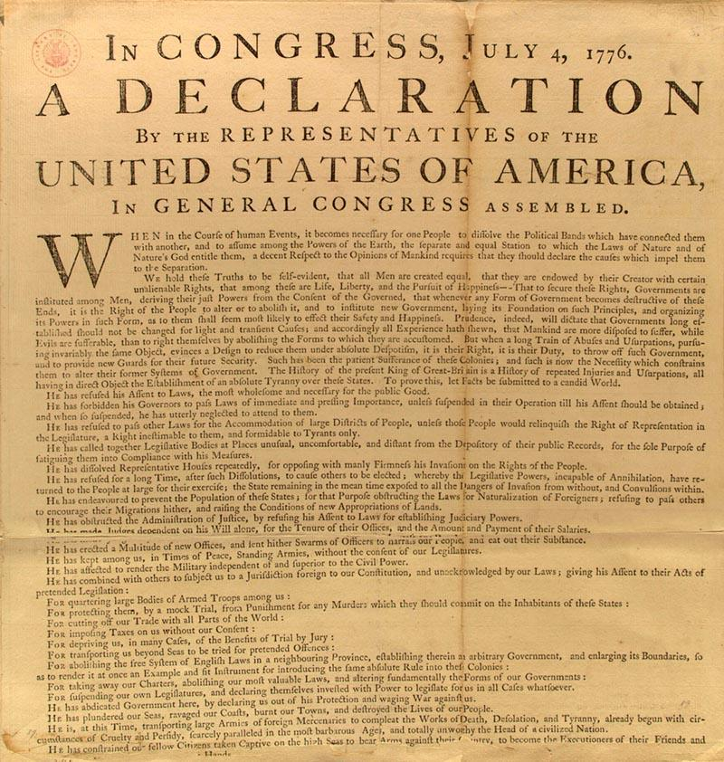
It´s Declarative

Slide 105
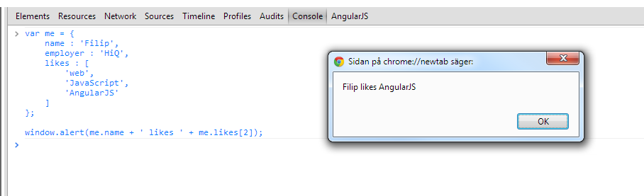
The Model is plain old JavaScript

Slide 106

Two way data binding

Slide 107

Modules

Slide 108

DOM manipulation done right

Slide 109

Routing

Slide 110

Services

Slide 111

Testable

Slide 112

No pollution of the Global scope

Slide 113

Less code means more time for slacking

